Slide 1
The Battle of Neighborhoods - Bangalore, India
-Suraksha Shetty
(Data Scientist)

Slide 2
Contents
Sl.No | Contents | Page Number
1. | Introduction | 3
 | - Img 1. Bangalore | 3
2. | Problem Description | 4
3. | Data Selection | 5
4. | Methadology | 6
 | - Table 1. Bangalore Data | 6
 | - Img 1. Bangalore map | 6
 | - Table 2. Foursquare Api Data | 7
 | - Table 3. One hot encoding data | 8
5. | Result | 9
 | - Table 4. Clustered Data | 9
 | - Img 3. Bangalore Cluster map | 10
6. | Discussion: | 11
 | - Table 5. Cluster 7 Data | 11
7. | Conclusion | 12
8. | Reference | 13

Slide 3
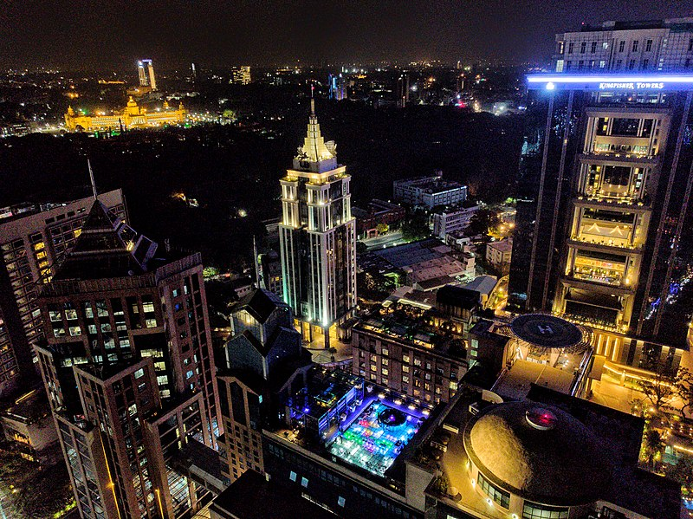
Introduction
Img 1. Bangalore
Bangalore, officially known as Bengaluru, is the capital of the Indian state of Karnataka. It has a population of over ten million, making it a megacity.

Slide 4
Problem Description
Imagine you have to move to the other side of Bangalore.
Wouldn't it be great if you are able to determine the neighborhoods on the other side of the city that are the same as your current neighborhood.
The aim of this report is to study and analyze the neighborhoods of Bangalore city and group them into similar clusters and, to analyze those clusters to gather meaningful information.

Slide 5
Data Selection
Bangalore Neighborhood Data:- This information is scraped from the website - http://www.geonames.org/export/zip/
Using Foursquare Location Data-Foursquare data is very comprehensive and it powers location data for Apple, Uber etc
We will then leverage this data in order to determine which locality is the most appropriate in order to locate the similar neighborhoods.

Slide 6
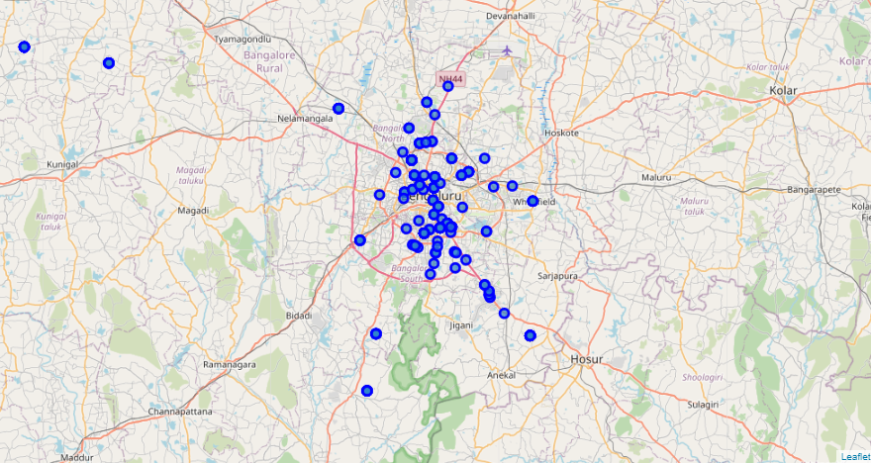
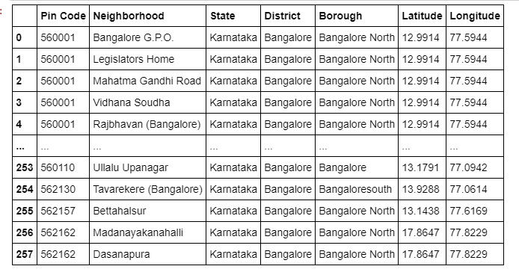
Methadology
Scraping the Geonames page and gathering data. ‘Bangalore’ borough data is filtered and plotted using Folium.
Table 1. Bangalore Data
Img 2. Bangalore map

Slide 7
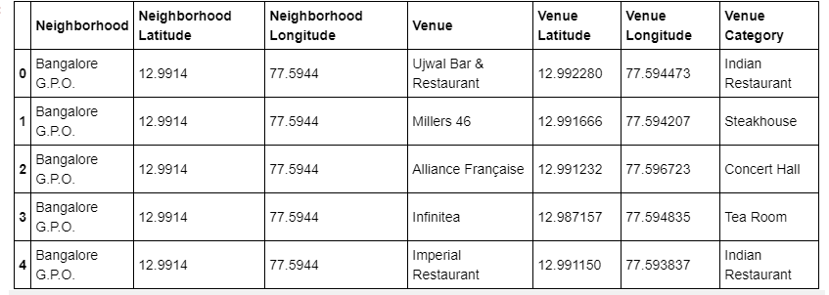
Methodology(Conti.)
Utilizing Foursquare API to explore the neighborhoods with the data of Geonames Data frame.
Table 2. Foursquare Api Data

Slide 8
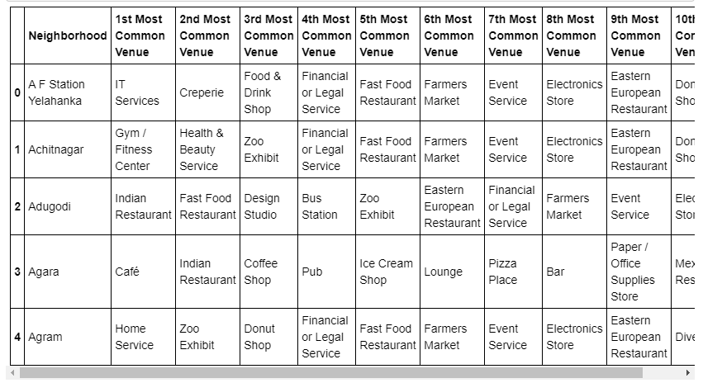
Methodology(Conti.)
Analyze each neighborhood using One Hot Encoding
Table 3. One hot encoding data

Slide 9
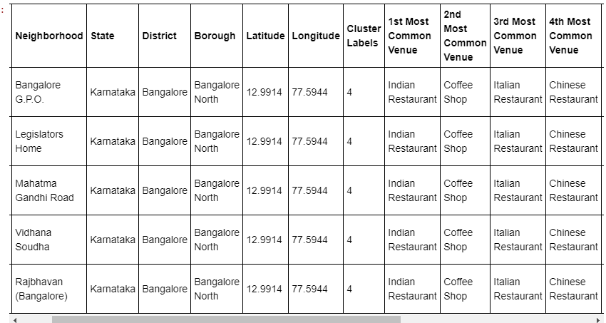
Result
Clustering Using k-means
Table 4. Clustered Data

Slide 10
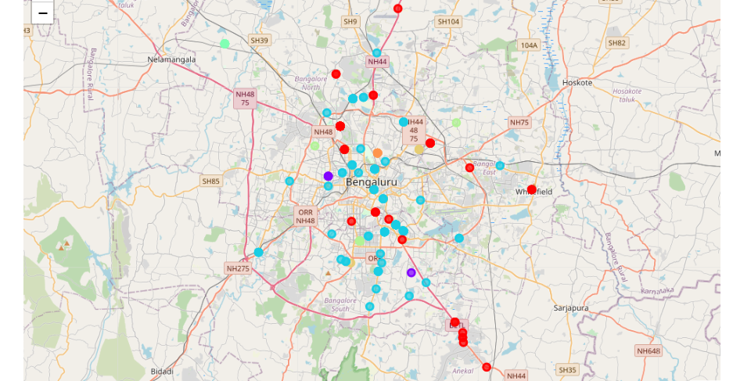
Result(conti.)
We use the matplotlib and folium packages to visualize the clusters on a map of Bangalore
Img 3. Bangalore Cluster map

Slide 11
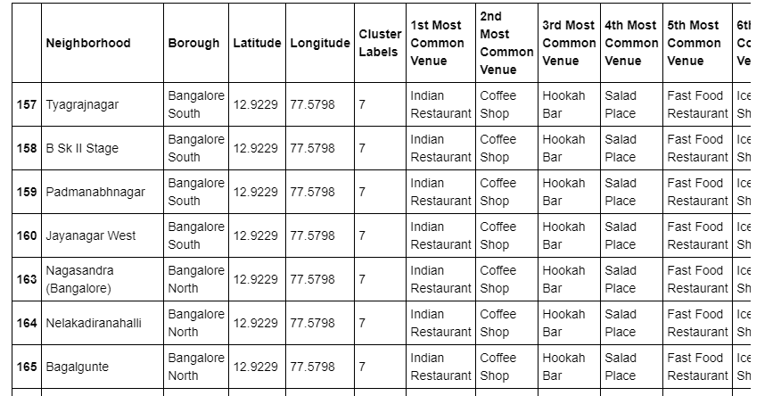
Discussion:
As seen in the table above, if a person wished to move from North Bangalore to South Bangalore. If a person’s current location were in the Neighborhood of Nagasandra in North Bangalore, which has venues like Indian Restaurant, Coffee shop nearby, the person, would like to relocate to a neighborhood like Jayanagar West in Bangalore South which also has venues like Indian Restaurant, Coffee shop and Hookah bar
Table 5. Cluster 7 Data

Slide 12
Conclusion:
In a fast moving world, there are many real life problems or scenarios where data can be used to find solutions to those problems. Like seen in the example above, data was used to cluster neighborhoods in Bangalore based on the most common venues in those neighborhoods. Similarly, data can also be used to solve other problems, which most people face in metropolitan cities.

Slide 13
Reference
https://en.wikipedia.org/wiki/Bangalore#/media/File:UB_City_at_night_.jpg
Geonames content: http://www.geonames.org/export/zip/
Foursquare API

Slide 14
Thank You

